Slide 1

How geography changes a woman’s life path?

Slide 2
Public Datasets
Labor force participation rate | https://genderdata.worldbank.org/indicators/sl-tlf-acti-zs/
Life expectancy at birth | https://genderdata.worldbank.org/indicators/sp-dyn-le-00-in/
Mean age at first marriage | https://genderdata.worldbank.org/indicators/sp-dyn-smam/
School enrollment, tertiary | https://genderdata.worldbank.org/indicators/se-ter-enrr/
World Bank Data – gender | https://github.com/light-and-salt/World-Bank-Data-by-Indicators/blob/master/gender/gender-raw-2021.csv

Slide 3
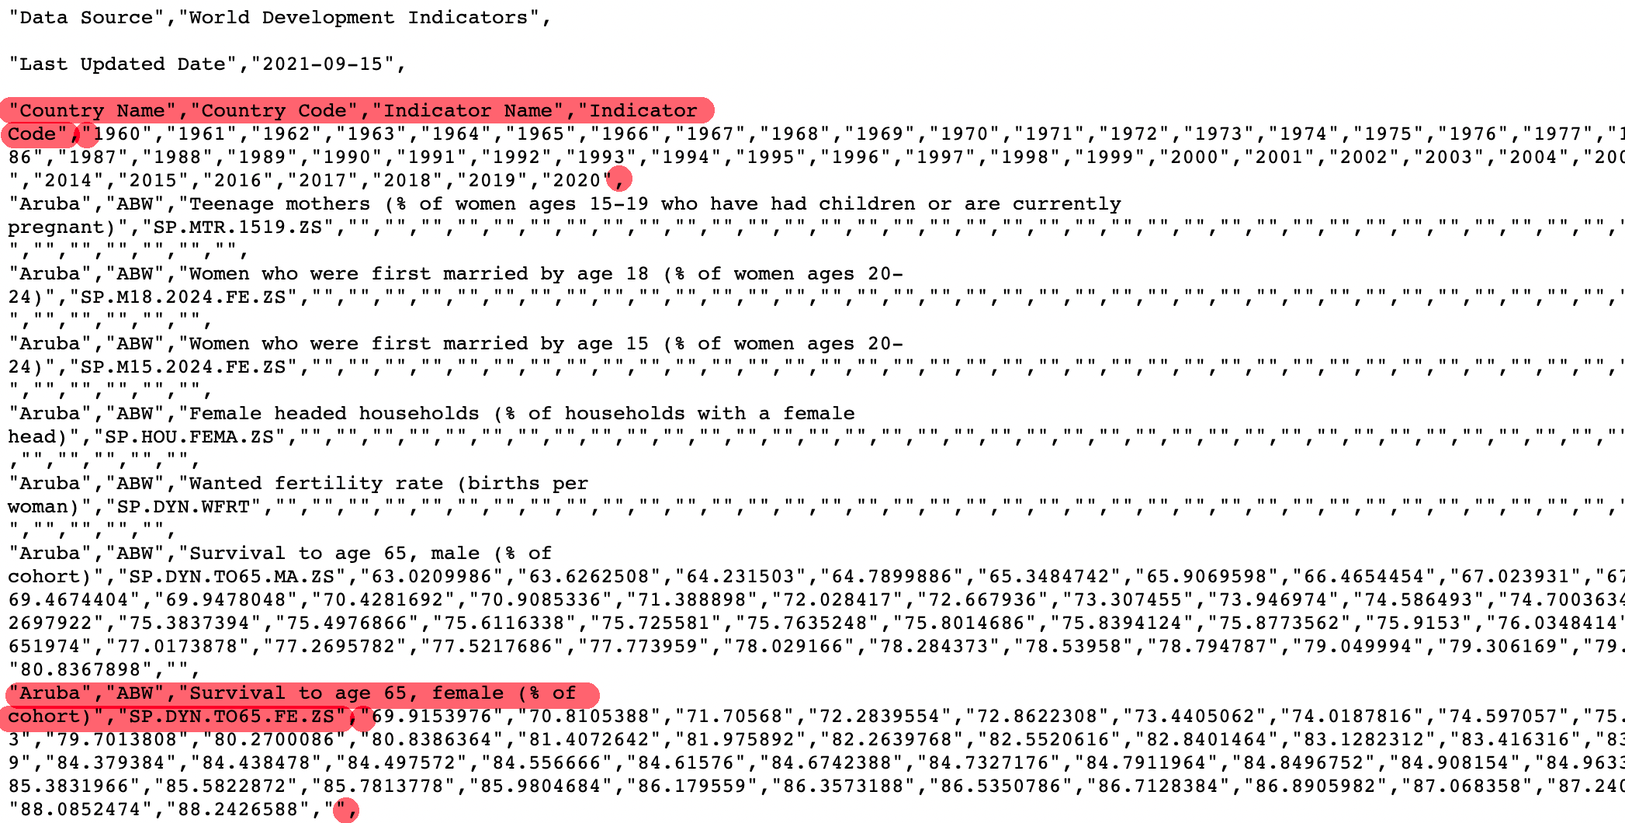
Public Datasets

Slide 4
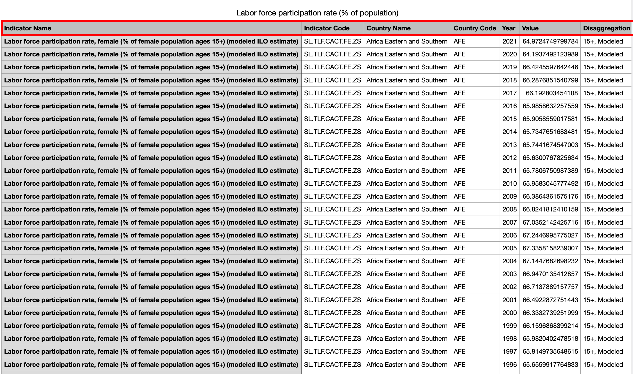
Public Datasets
Labor force participation rate
Life expectancy at birth
Mean age at first marriage
School enrollment, tertiary
……

Slide 5
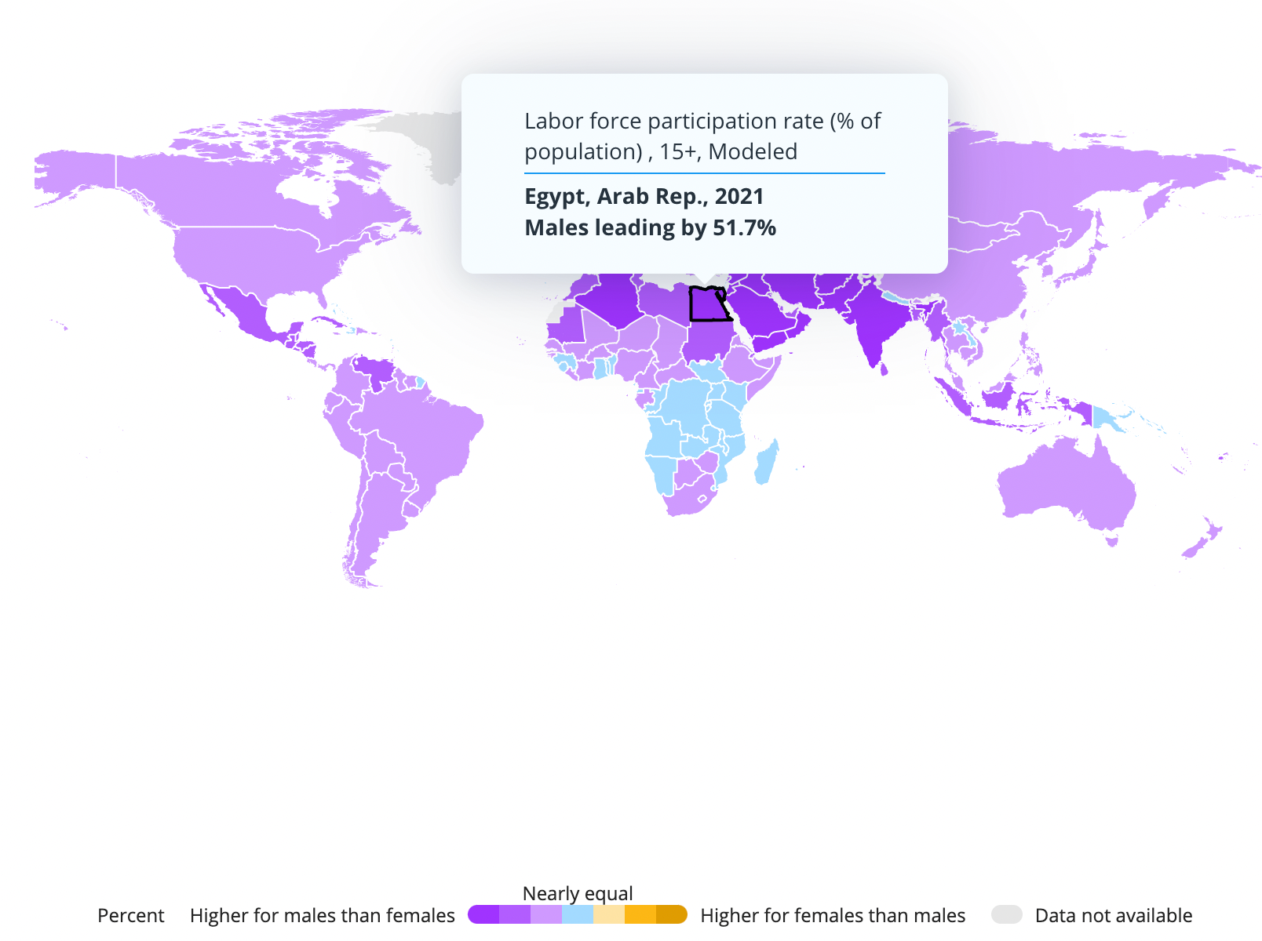
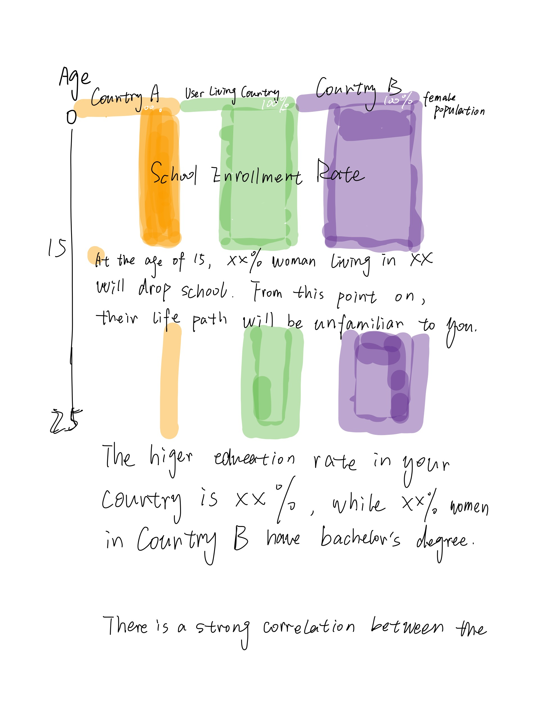
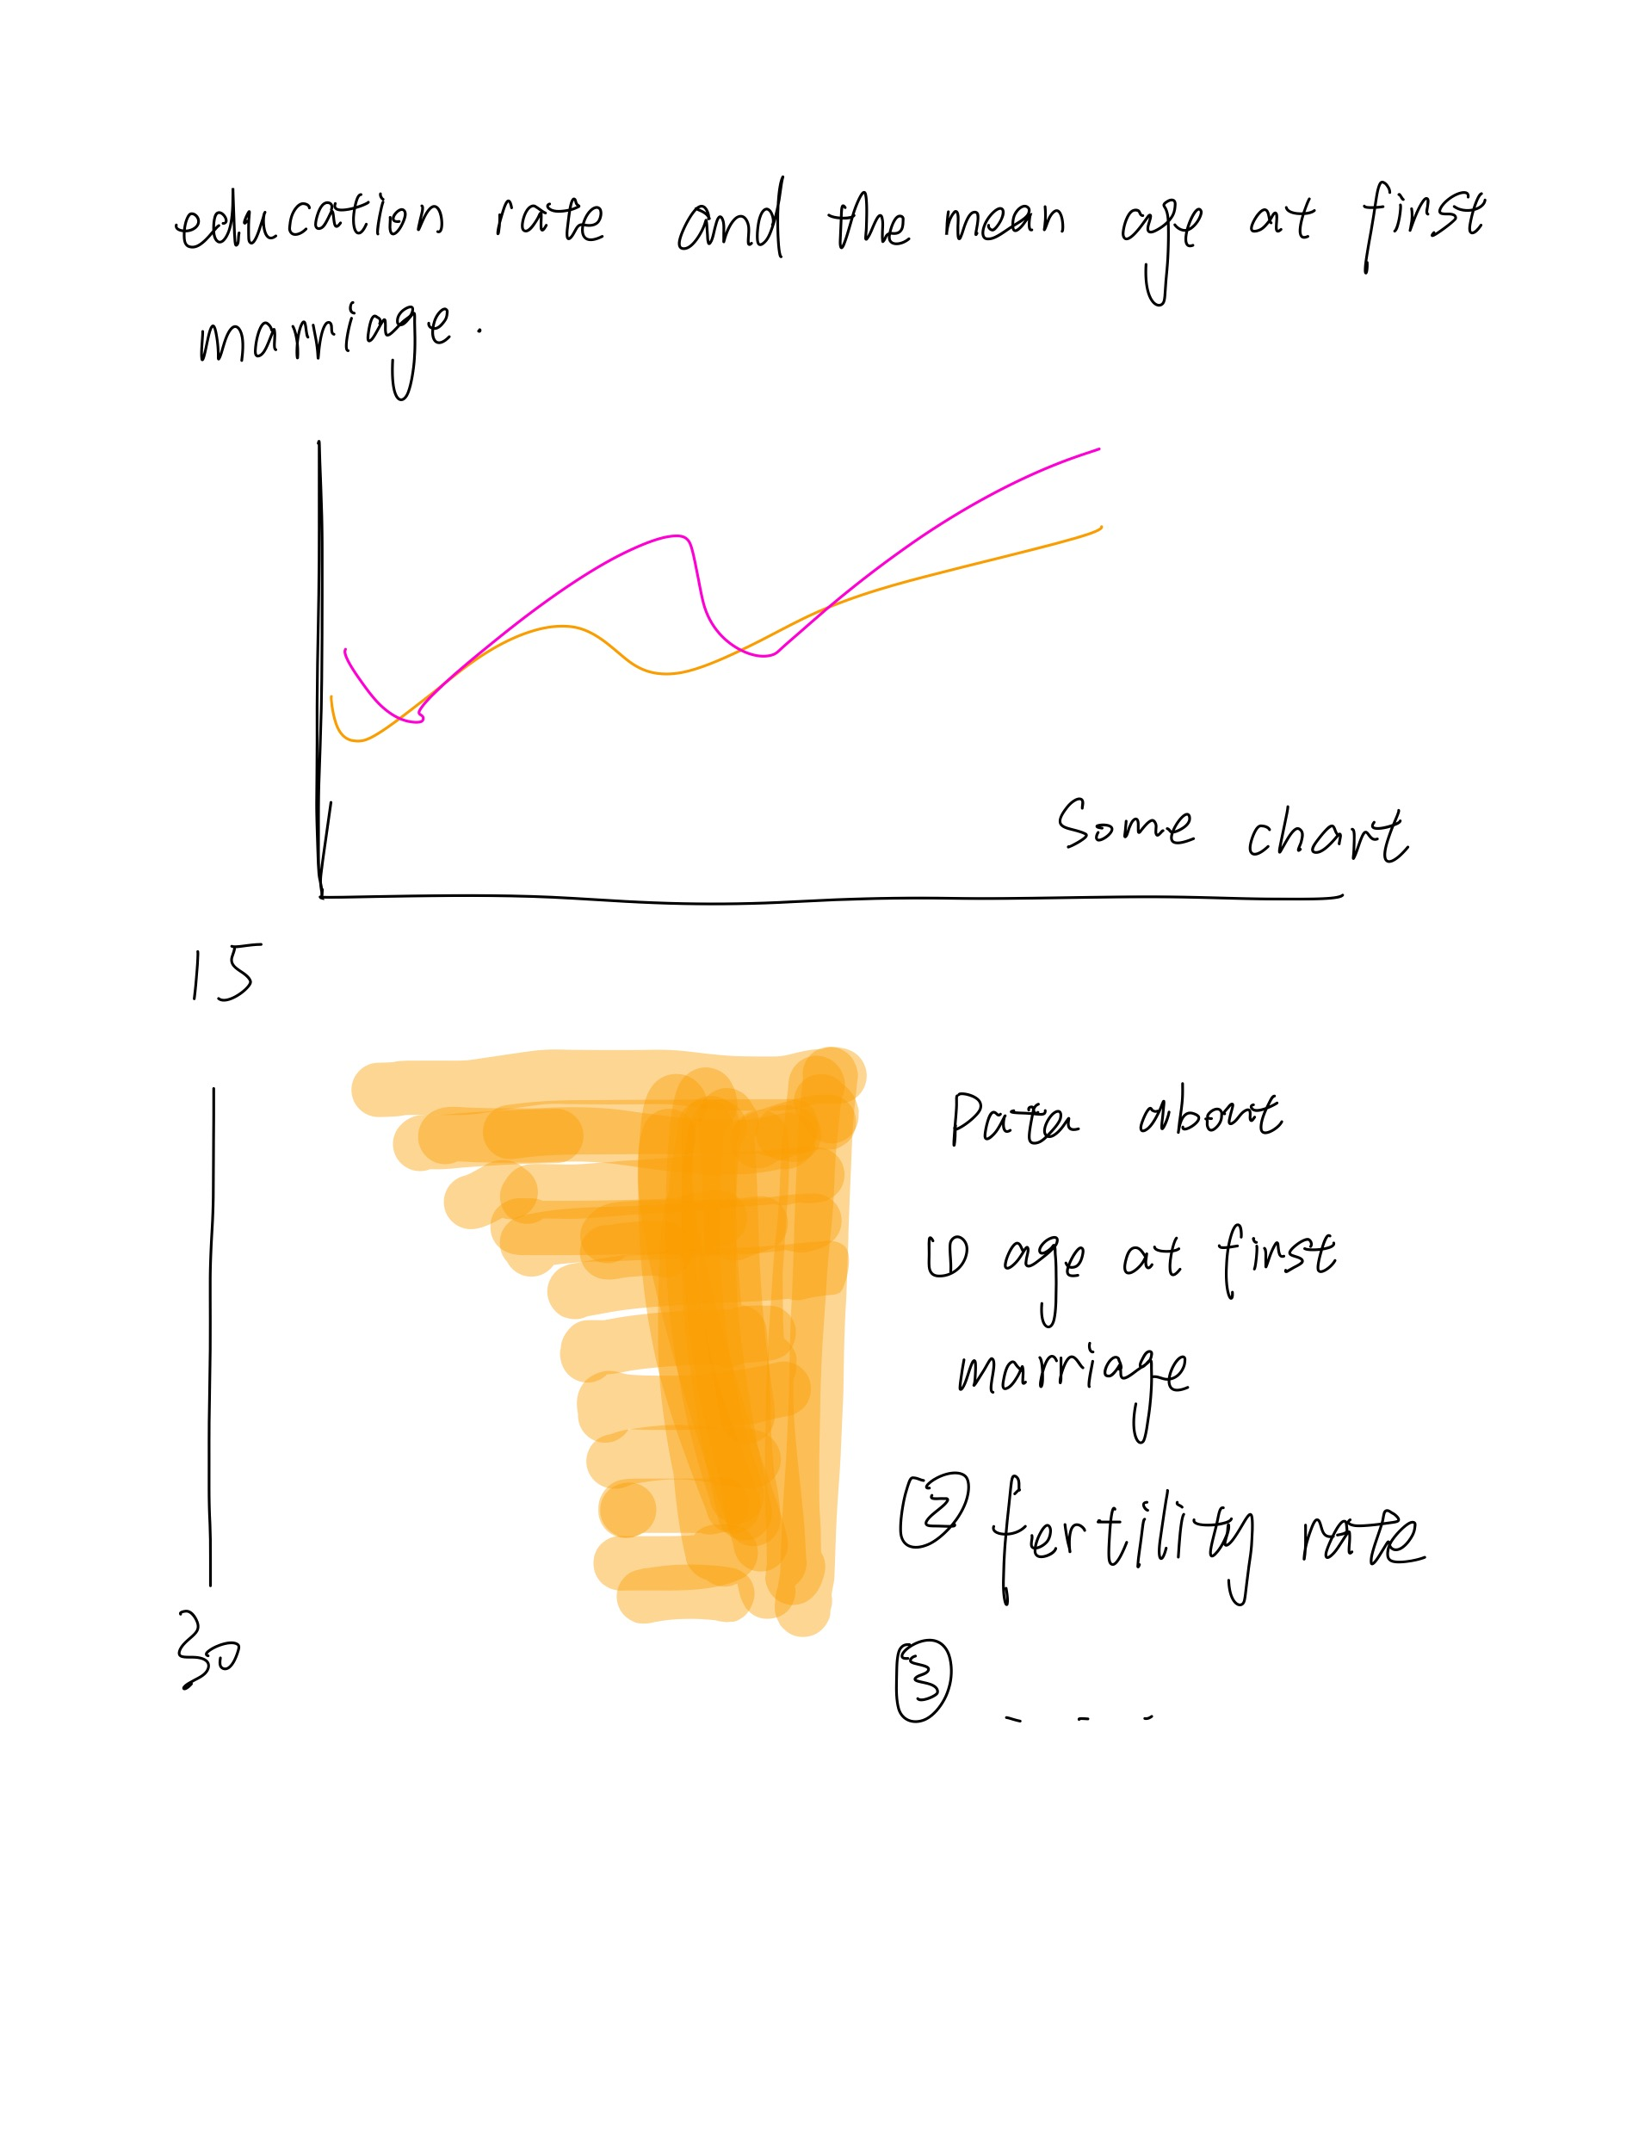
Draft
Age Timeline
Rectangles :
the "loss" of women along the way

